Slide 1


Data Cleaning with Pandas
National Student Leadership Conference
2022

Slide 2
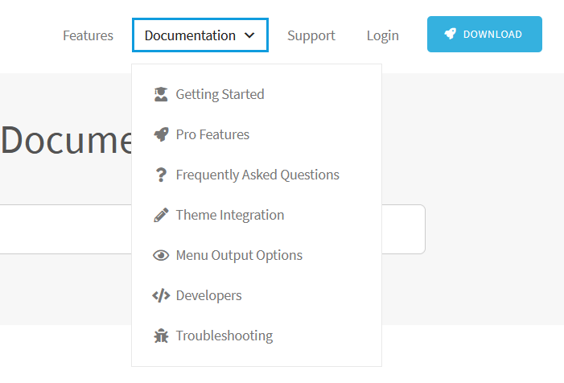
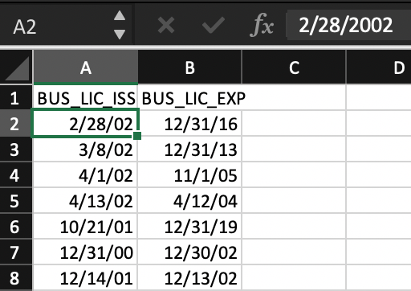
What is Data Cleaning?
Before data can be fully analyzed, it must be cleansed of any incorrect, incomplete, irrelevant, duplicated, or improperly formatted data. Once the data is organized, then it can be analyzed.

Slide 3
How does it differ from Data Validation?
Data validation occurs as data is initially entered into the database. Data cleaning can take place any time after to catch any more data that has been formatted incorrectly.
Data Cleaning
Unknown
Data Validation
Input Sensitive Program
Unknown Inputs
Known Inputs

Slide 4
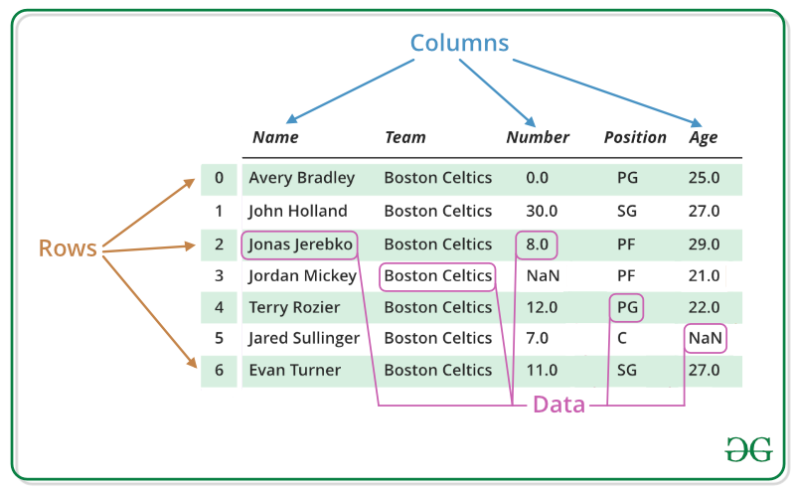
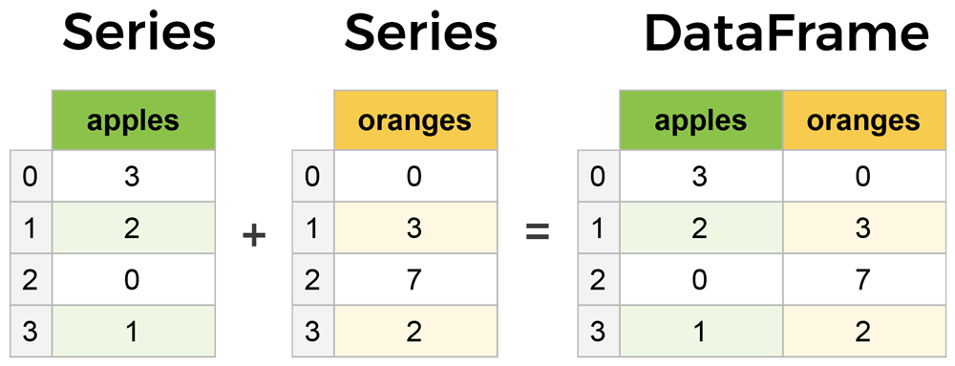
How do we use large batches of data?
Data Frames
Think of a data frame as a super large excel file
Imagine having to go through all of this data manually
Data frames are how we put this excel style of data into code so that we can easily manipulate it

Slide 5
For Example
Say you work for a company that’s asked you to determine the overall financial worth of each of its employees.
You might pull data archived time sheets to get data about hours worked and the amount paid over time.
-You may need look through reports of projects they worked on to determine the quality of their work based off something like project costs or value.
-You may need to send out surveys to obtain data of interpersonal values brought to the company like leadership abilities, comradery, etc. (determining the value of this is another story, and usually depends on the companies mission and mindset)

Slide 6




For Example
Say you work for a company that’s asked you to determine the overall financial worth of each of its employees.
Hours
Project Success
Social Interaction

Slide 7
Example continued
Each of these pieces of data will take a wildly different form, but ultimately holds information for the target- the employees.
Data cleaning will allow us to combine all this data together into an organized format we can easily analyze.

Slide 8
Why clean it?
We clean data for the same reason we comment code. So people can more easily understand it.
However there’s a more pragmatic reason: Computer Memory
Though Computer memory has become exponentially cheaper, we have matched it by producing exponentially more data. If we’re combining data from several different sources, it’s very easy for our file sizes to get out of hand, leading to crashes and slow performance. We have to keep only what we need so computers can crunch our numbers effectively.
Pandas is a python package with many built in functions for data cleaning.

